Slide 1

Singapore Data Analysis
Pandu Gusti Resworo
DQLab Bootcamp Data Analyst
with Python and SQL

Slide 2
Introduction
This work is the capstone project of DQLab’s data analytics bootcamp. The datasets for this project were obtained from Inside Airbnb using the Singapore region data scraped on September 2022.
The project is coded with Python through the Jupyter Notebook, and mainly oriented towards descriptive analysis. For your convenience, the notebook and datasets used can be found on my GitHub repository here.

Slide 3
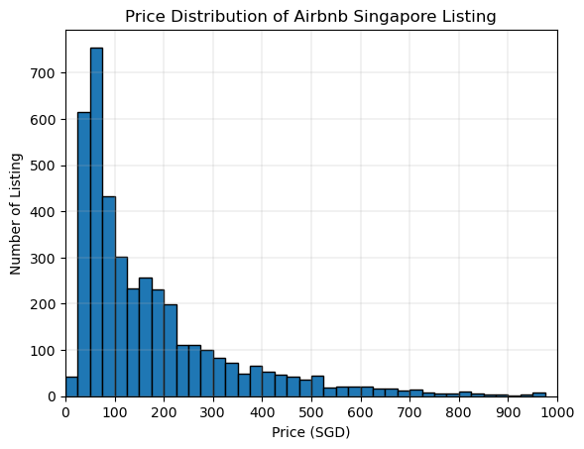
Price Distribution
Count | 4160 Listing
Mean | 214.5 SGD
Median | 120 SGD
Min | 13 SGD
Max | 12,494 SGD
From 4160 listings in Singapore, the prices are widely spread out from as low as 13 SGD up to 12,494 SGD.
However, 50% of the listing is priced below 120 SGD.

Slide 4
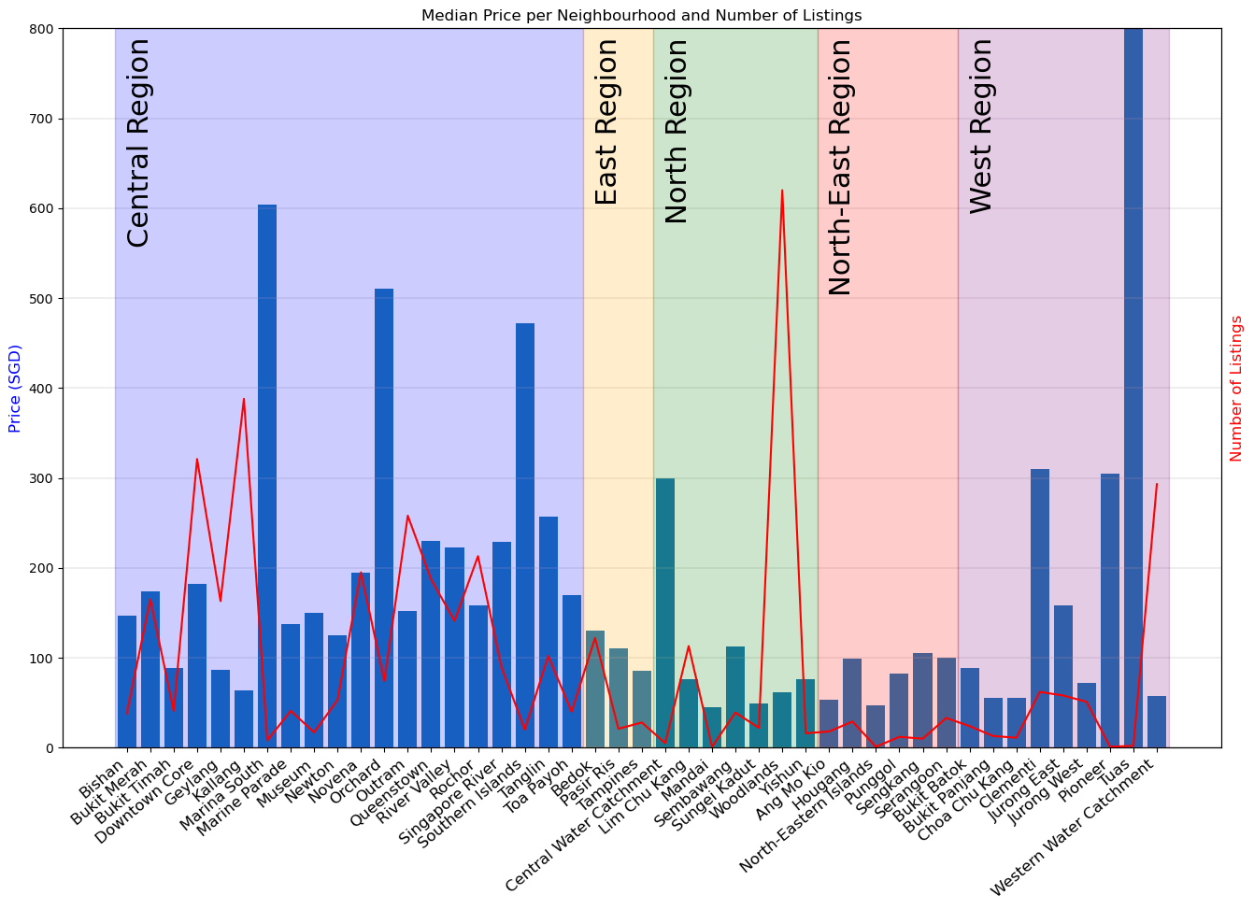
Neighbourhood
Analysis
The Central Region has most number of neighbourhoods. (20)
Woodlands of the North Region has the most number of listings. (620)
Certain neighbourhoods are more 'expensive' than others. However, some of those neighbourhoods does not have as many listings as others.
For example, “Tuas” only has two listing and one them is a 10,000 SGD penthouse.

Slide 5
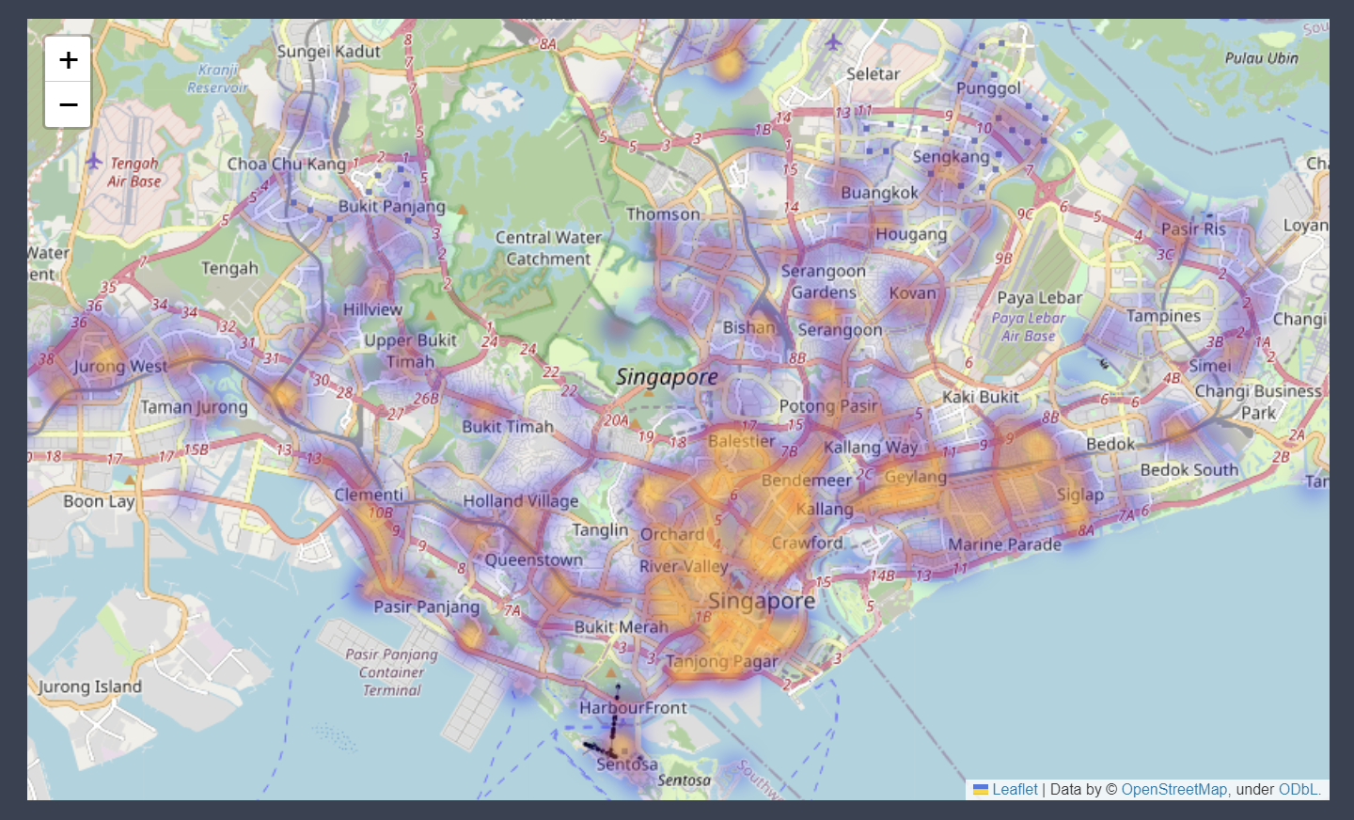
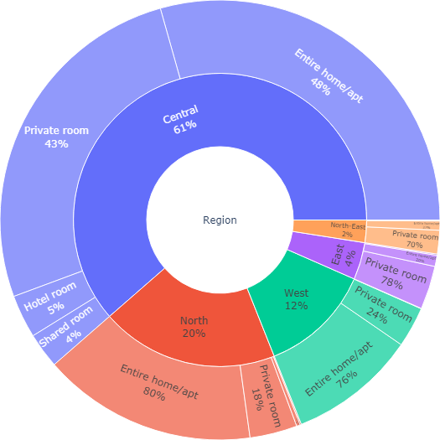
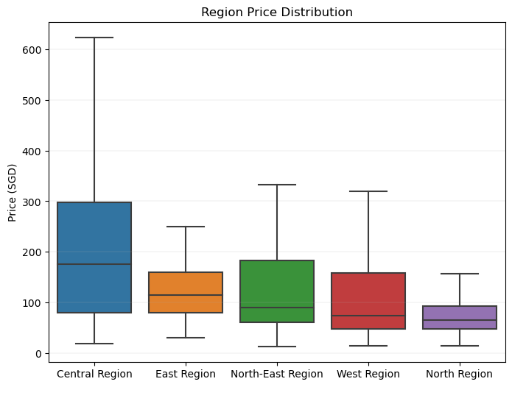
Region Analysis
The Central Region has the most listing in the whole of Singapore, and is also the most expensive.
The North Region, the region with the second most number of listing, is the cheapest.
Neighbourhood Group | Number of Listings | Median Price (SGD)
Central Region | 2555 | 175
North Region | 816 | 65
West Region | 515 | 74
East Region | 171 | 115
North-East Region | 103 | 90

Slide 6

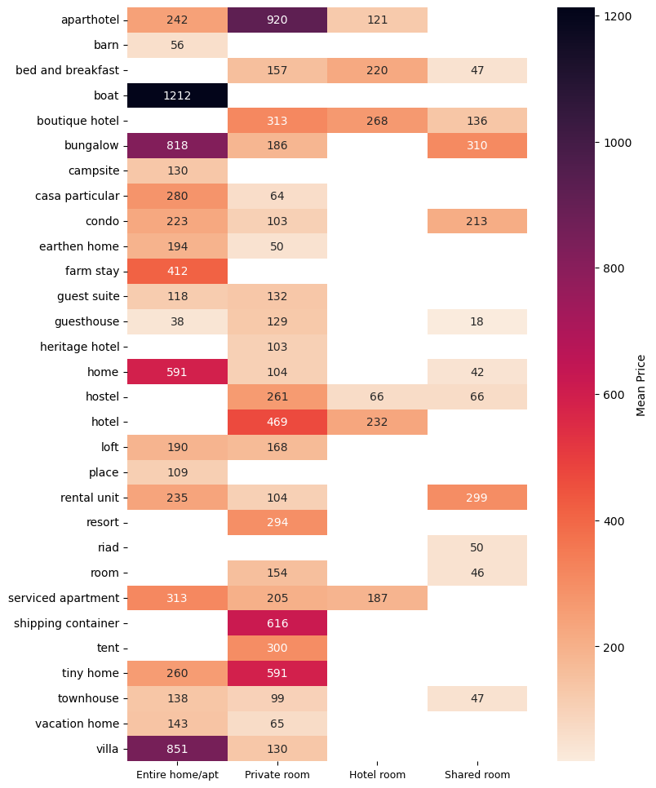
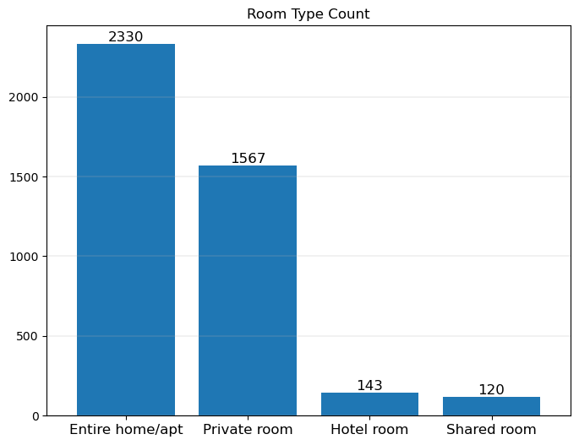
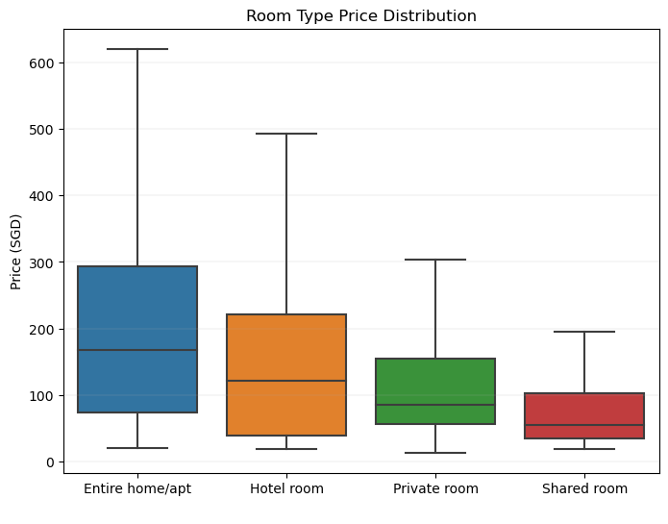
Room Type and Price Analysis
In general, entire home/apt are the most common and the most expensive, while the shared room is the cheapest. However, the prices may vary on certain property types. An unique kind of property could skew the statistics.
For example, an entire barn is cheaper than a room on a hotel or a shipping container. An entire boat would also be extremely expensive.

Slide 7
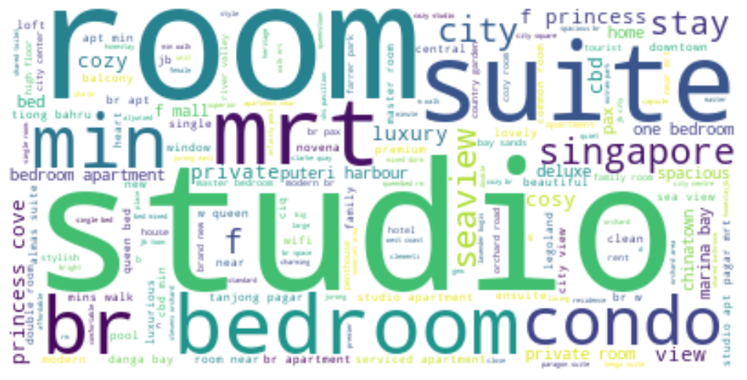
Listing Name Analysis
Hosts are using simple and descriptive words that help users to have an idea of the listing without clicking on it.
Words like "studio", "suite" and "condo" describe the property type, and then the hosts can elaborate more with descriptions and pictures.
"MRT", "Min" and "Bedroom" are all words that appear often to describe the feature and the location of the listing.

Slide 8
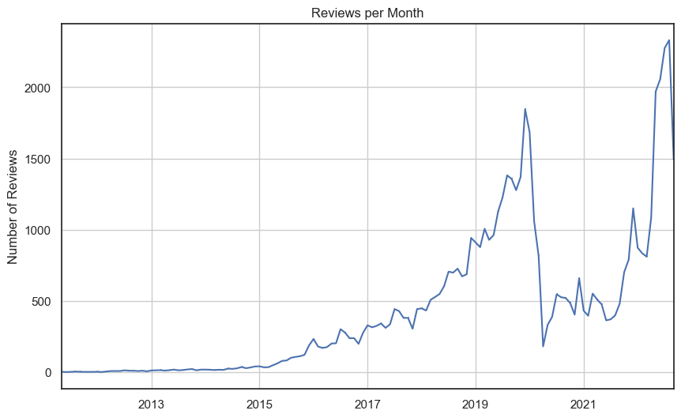
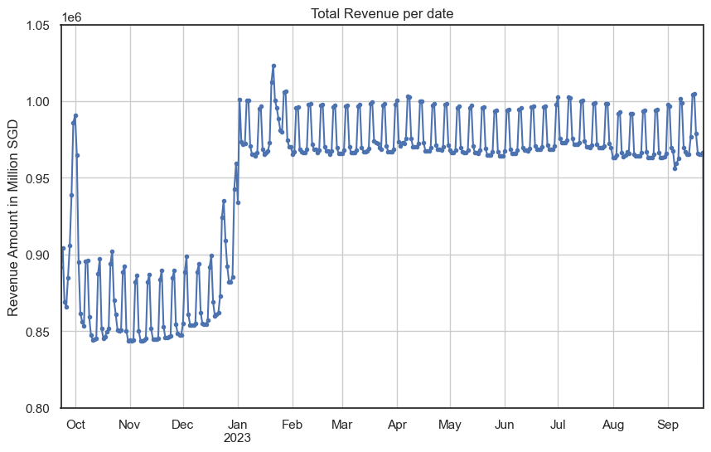
Calendar and Reviews Analysis
The Airbnb business has been on a steady incline since the beginning of its operation until the beginning of 2020. The Covid-19 pandemic severely impact Singapore as seen on the Reviews per Month plot.
In 2022, the industry has rebounded and hits an all-time high of 2331 reviews on August 2022.
From the calendar dataset we can also infer that there’s going to be at least 15% increase of revenue for 2023

Slide 9
Analysis of Top 100 Listing Based on the Number of Reviews

Slide 10
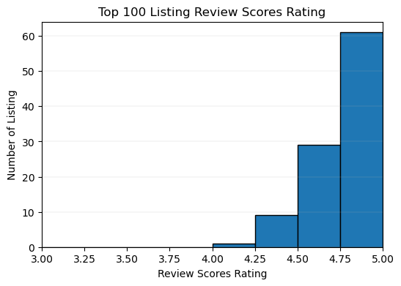
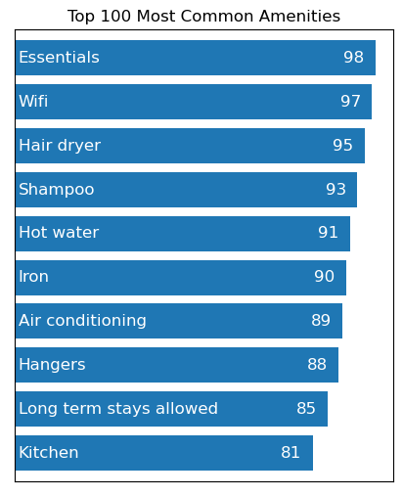
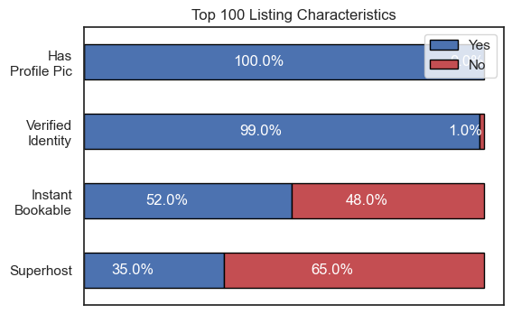
Top 100
Characteristics and Features
All the Top 100 Listings have more than 4.0 Review Scores with 60% of the listings at the 4.75-5.00 range.
The most shared characteristics are that the host has profile picture and has their identity verified. While the instant bookable feature and the superhost status doesn’t affect the listing performance.
There are shared common amnesties that the top 100 listing shares, such as essentials, wifi, and various bathroom amenities.

Slide 11
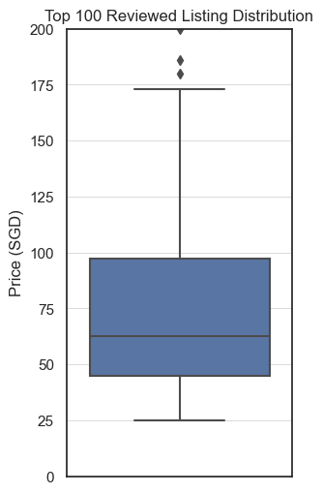
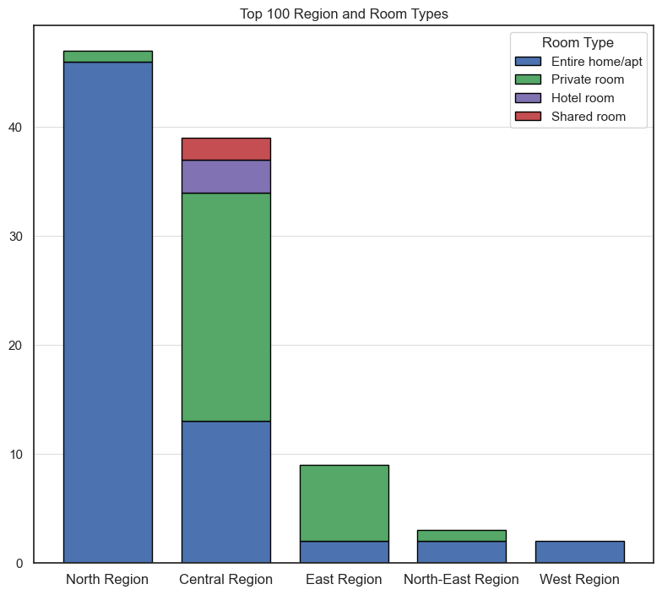
Top 100
Price and Location
The top 100 listings is mostly priced below 100 SGD with a few outliers that goes up to 819 SGD.
Most of the top 100 listings are located in the North Region and Central Region.
The Entire home/apt being the most rented type and the Private room as the second most rented type.
Mean | 96.94 SGD
Median | 62.5 SGD
Min | 25.0 SGD
Max | 819.0 SGD

Slide 12
Summary
The median price of 4160 Airbnb listings in Singapore is 120 SGD.
The Central Region has most number of neighbourhoods.
Woodlands of the North Region has the most number of listings.
Central Region has the most number of listing and is also the most expensive.
Entire home/apt are the most common and the most expensive.
Hosts are using simple and descriptive words for the listing name.
Airbnb industry in Singapore is on the rise and the revenue for 2023 is expected to increase at least 15% .
The top 100 listing shares many characteristics and amenities.
Most of the top 100 listing are priced under 100SGD and located on the North and Central Region. With Entire home/apt being the most rented type.

Slide 13
